Slide 1



Uber Dashboard- Impact of weather & seasonality
By Sivakumar KP

Slide 2
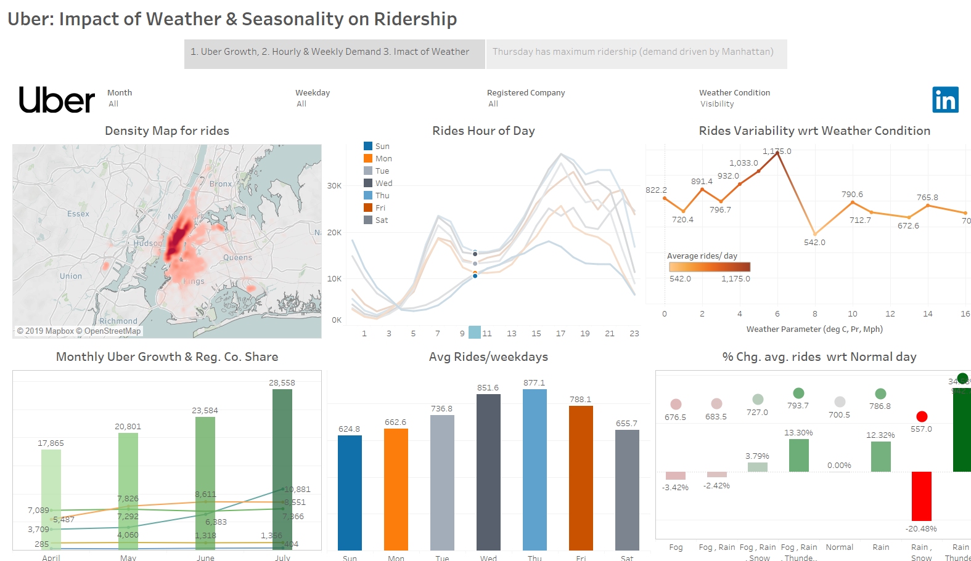

Slide 3
